Slide 1
Session 02
Learning the Java Language
(http://docs.oracle.com/javase/tutorial/java/index.html)
Session 02 - Learning the Java Language

Slide 2
Objectives
Study some fundamentals of Java languages: Data types, variables, arrays, operators, logic constructs.
Pass arguments to the main method
Input/output variables
Object-Oriented Programming Concepts: Class, Interface, Package.
Session 02 - Learning the Java Language

Slide 3
Keywords and Identifiers
Keywords: Almost of them are similar to those in C language
Naming Convention:
Letter
$
_
Letters
Digits, $
_
Java is a case-sensitive language
Identifiers must be different to keywords
<number>/40

Slide 4
Primitive Data Types - Variables
Type | Bytes | Minimum | Maximum
char | 2 | \u0000 | \uFFFF
byte | 1 | -2⁷ | 2⁷ - 1
short | 2 | -2¹⁵ | 2¹⁵ – 1
int | 4 | -2³¹ | 2³¹ – 1
long | 8 | -2⁶³ | 2⁶³ - 1
float | 4
double | 8
boolean | true/false
A primitive is a simple non-object data type that represents a single value. Java’s primitive data types are:
Type var [=Initial value] ;
Session 02 - Java Fundamentals

Slide 5
Operators
Category (Descending Precedence) | Operators
Unary | ++ -- + - ! ~ (type)
Arithmetic | * / % + -
Shift | << >> >>>
Comparison | < <= > >= instanceof == !=
Bitwise | & ^ |
Short-circuit | && ||
Conditional | ?:
Assignment | = op=
They are the same with those in C language
Session 02 - Learning the Java Language

Slide 6
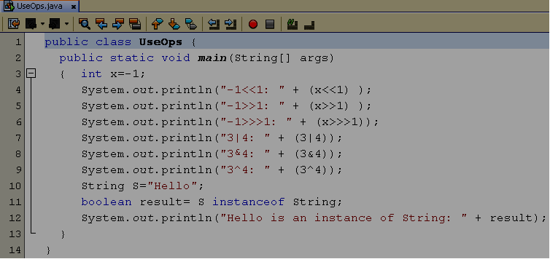
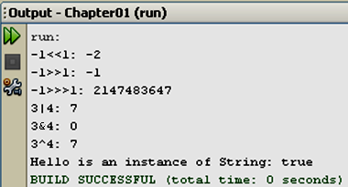
Using Operators Demonstration
<number>/40

Slide 7
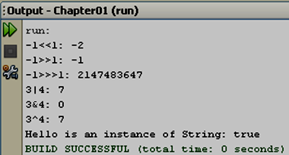
Using Operators Demonstration
Use 2 bytes to store value
1: ➔ 0000 0000 0000 0001
1111 1111 1111 1110 ( 1-complement)
-1 ➔ 1111 1111 1111 1111 ( 2-complement)
-1 <<1 ➔ 1111 1111 1111 1110 (-2)
-1 ➔ 1111 1111 1111 1111
-1 >>1 ➔ 1111 1111 1111 1111
-1 ➔ 1111 1111 1111 1111
-1 >>>1 ➔ 0111 1111 1111 1111 (2147483647)
3 ➔ 0000 0000 0000 0011
4 ➔ 0000 0000 0000 0100
3|4 ➔ 0000 0000 0000 0111 (7)
3 ➔ 0000 0000 0000 0011
4 ➔ 0000 0000 0000 0100
3&4 ➔ 0000 0000 0000 0000 (0)
3 ➔ 0000 0000 0000 0011
4 ➔ 0000 0000 0000 0100
3^4 ➔ 0000 0000 0000 0111 (7 ): XOR BIT
<number>/40

Slide 8
Literals and Value Variables
Character: ‘a’
String: String S=“Hello”;
Escape sequences: see the page 10
Integral literals:
28, 0x1c, 0X1A ( default: int). 123l, 123L (long)
Floating point:
  1.234 (default: double)
  1.3f 1.3F
  1.3E+21
  1.3d 1.3D
Value variable
Stack
n
10
int n=10;
<number>/40

Slide 9
Java Expressions
Java is an expression-oriented language. A simple expression in Java is either:
  A constant: 7, false
  A char - literal enclosed in single quotes: 'A', '3‘
  A String - literal enclosed in double quotes: "foo“
  The name of any properly declared variables: x
  Any two|one of the preceding types of expression that are combined with one of the Java binary operators: i++, x + 2, (x + 2)
Session 02 - Java Fundamentals

Slide 10
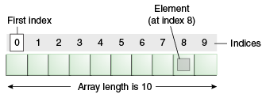
One Dimensional Arrays (1)
An array is a container object that holds a fixed number of values of a single type.
The length of an array is established when the array is created.
Each item in an array is called an element, and each element is accessed by its numerical index.
Session 02 - Java Fundamentals

Slide 11
One Dimensional Arrays (2)
Declaring a Variable to Refer to an Array
int[] anArray;
  or float anArrayOfFloats[];
Creating, Initializing, and Accessing an Array
anArray = new int[10];
Copying Arrays
  Use arraycopy method from System class.
Session 02 - Java Fundamentals
Notes:
class ArrayCopyDemo {
public static void main(String[] args) {
char[] copyFrom = { 'd', 'e', 'c', 'a', 'f', 'f', 'e', 'i', 'n', 'a', 't', 'e', 'd' };
char[] copyTo = new char[7];
System.arraycopy(copyFrom, 2, copyTo, 0, 7);
System.out.println(new String(copyTo));
}
}

Slide 12
One Dimensional Arrays (3)
int[] ar;
ar= new int[3];
ar[0]=1; ar[1]=2; ar[2]=3;
int a2[];
int[] a3 = {1,2,3,4,5};
int a4[] = {1,2,3,4,5};
3
Heap
2
10000
1
Stack
ar
10000
Array is a reference variable
int n=10;
<number>/40

Slide 13
Multiple Dimensional Arrays
10
2002
9
2001
500
92
500
8
91
200
200
7
100
4
6
8000
5
3
1000
8000
2
replacement
1000
m
1
100
int m[][]= { {1,2,3,4}, {91,92}, {2001,2002}};
int[] replacement = {5,6,7,8,9,10};
m[1]= replacement;
m[i][j]
int[][] m; // declare a matrix
int r=10, c=5; // number of rows, columns
m= new int[r][c]; // memory allocate
<number>/40

Slide 14
Evaluating Expressions and Operator Precedence
The compiler generally evaluates such expressions from the innermost to outermost parentheses, left to right.
  int x = 1; int y = 2; int z = 3;
  int answer = ((8 * (y + z)) + y) * x;
  would be evaluated piece by piece as follows:
  ((8 * (y + z) ) + y) * x
  ((8 * 5) + y) * x
  (40 + y) * x
  42 * x
  42
Session 02 - Java Fundamentals

Slide 15
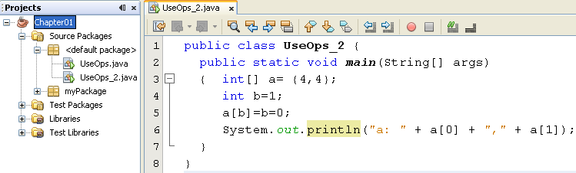

Operator Precedence- Evaluation Order
Order:
[ ] ➔ a[b] ➔ a[1]
= ( from the right) ➔ b=0 ➔ return 0
➔ a[1] = 0
<number>/40

Slide 16
The Basic Constructs
Java provides three loop constructions. Taken from C and C++, these are:
  while(),
  do ,
  for().
JAD Session 3 - Flow Control,
Assertions, and
Exception Handling
<number>/33

Slide 17
The while() Loop
  while (boolean_condition)
  {
  statement(s);
  }
JAD Session 3 - Flow Control,
Assertions, and
Exception Handling
<number>/33

Slide 18
The do Loop
do {
do_something
do_more
} while (boolean_condition);
JAD Session 3 - Flow Control,
Assertions, and
Exception Handling
<number>/33

Slide 19
The for() Loop
for (statement ; condition ; expression) {
do_something
do_more
}
JAD Session 3 - Flow Control,
Assertions, and
Exception Handling
<number>/33

Slide 20
Enhanced for Loops
Java’s for loops were enhanced in release 1.5 to work more easily with arrays and collections.
Syntax:
for (type variable_name:array)
  int sumOfLengths(String[] strings) {
  int totalLength = 0;
  for (String s:strings) totalLength += s.length();
  return totalLength;
  }
JAD Session 3 - Flow Control,
Assertions, and
Exception Handling
<number>/33

Slide 21
The continue Statements in Loops (for, while, do)
for( .;.;.)
{
  //process part 1
  if(condition)
  continue;
  //process part 2
}
mainloop:for(.;.;.){
for( .;.;.)
{
  //process part 1
  if(boolean_exp)
  continue mainloop;
  //process part 2
}
}
JAD Session 3 - Flow Control,
Assertions, and
Exception Handling
<number>/33

Slide 22
The break Statements in Loops (for, while, do)
for( .;.;.)
{
  //process part 1
  if(condition)
  break;
  //process part 2
}
JAD Session 3 - Flow Control,
Assertions, and
Exception Handling
<number>/33

Slide 23
The Selection Statements
x must be
either
byte, short,
char, or int. Cannot be long
The if()/else Construct
The switch() Construct
switch (x) {
case 1:
System.out.println("Got a 1");
break;
case 2:
case 3:
System.out.println("Got 2 or 3");
break;
default:
System.out.println("Not a 1, 2, or 3");
break;
}
JAD Session 3 - Flow Control,
Assertions, and
Exception Handling
<number>/33

Slide 24
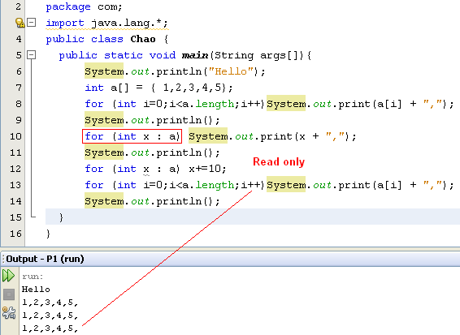
Basic Logic Constructs example
They are the same with those in C-statements
An enhanced for loop
a
1
2
3
4
5
x
1
<number>/40

Slide 25
The String type
A String represents a sequence of zero or more Unicode characters.
  String name = "Steve";
  String s = “”;
  String s = null;
String concatenation.
  String x = "foo“ + "bar“ + "!";
Java is a case-sensitive language.
Session 02 - Java Fundamentals

Slide 26
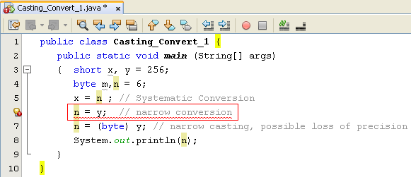
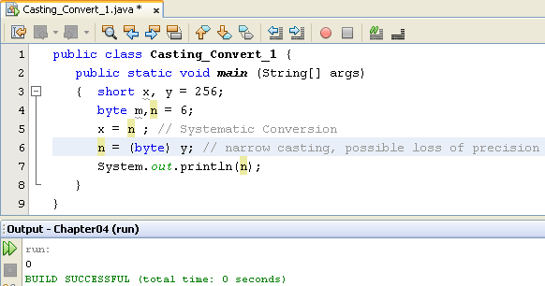
Type Conversions and Explicit Casting
* Widening Conversion: OK
Narrowing conversion: Not allowed. We must use explicit casting.
A boolean can not be converted to any other type.
A non-boolean can be converted to another non-boolean type.
0000 0001
0000 0000
0000 0000
y
n
<number>/34

Slide 27
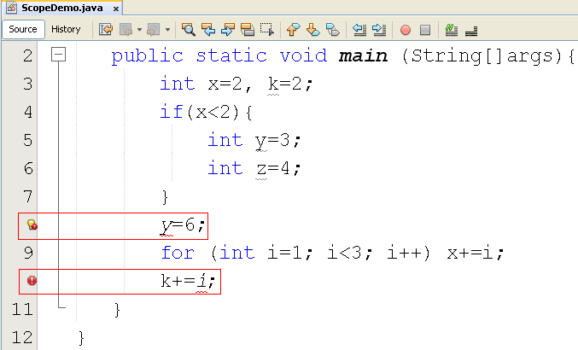
Scope of a Variable
Scope of the variable y
Scope of the variable i
Session 02 - Java Fundamentals

Slide 28
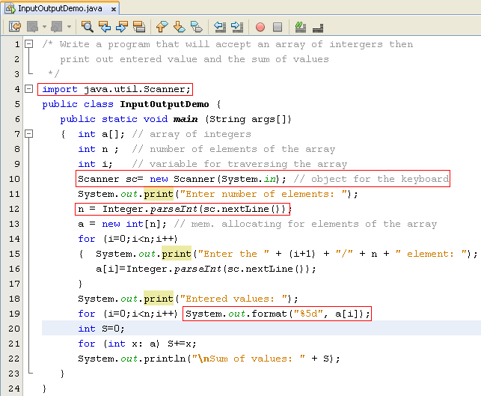
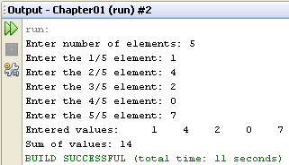
Input/Output Data
Class java.lang.System
Class java.util.Scanner
Refer to Java documentation:
java.lang.String class,
- the format method,
- format string
for more details
n= sc.nextInt();
Session 02 - Java Fundamentals

Slide 29
Elements of Java Style
Proper Use of Indentation
  Statements within a block of code should be indented relative to the starting/ending line of the enclosing block.
Use Comments Wisely
Placement of Braces
  Opening brace at the end of the line of code that starts a given block. Each closing brace goes on its own line, aligned with the first character of the line con.
Descriptive Variable Names
Session 02 - Java Fundamentals
Notes:
Comments wisely: If there can be any doubt as to what a passage of code does, precede it with a comment.
• Indent each comment to the same level as the block of code or statement to which it applies.
• Make sure that all comments add value—don’t state the obvious, as in the following fairly useless comment

Slide 30
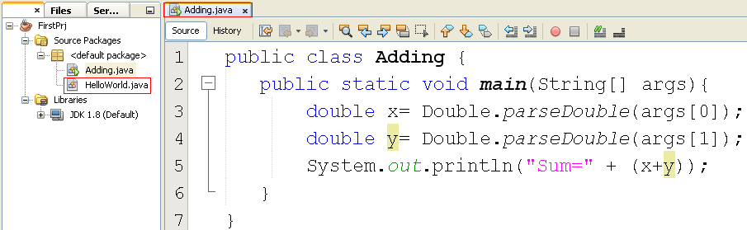
Pass Arguments to the method main
Session 02 - Learning the Java Language

Slide 31
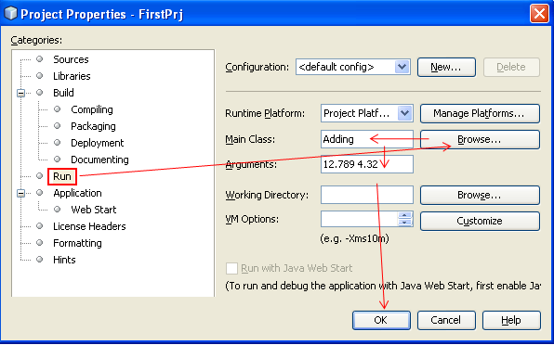
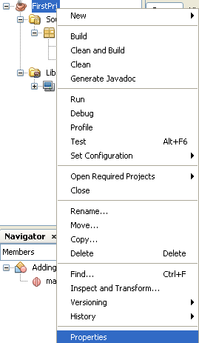
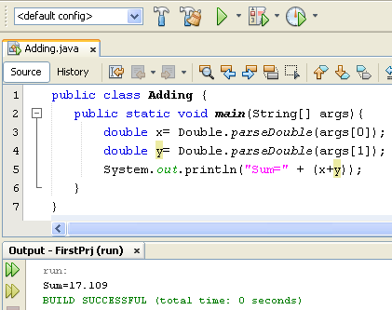
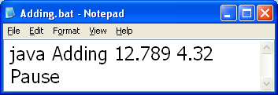
Pass Arguments to the method main
Session 02 - Learning the Java Language

Slide 32

What is an Object?(1)
Objects are key to understanding object-oriented technology.
Examples of real-world objects: your dog, your desk, your television set, your bicycle.
Real-world objects share two characteristics: They all have state and behavior.
  Dogs have state (name, color, breed, hungry) and behavior (barking, fetching, wagging tail).
Session 02 - Learning the Java Language

Slide 33
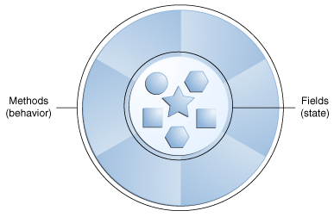
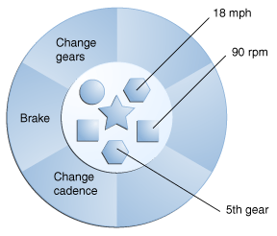
What is an Object?(2)
Software objects are conceptually similar to real-world objects: they too consist of state and related behavior.
An object stores its state in fields and exposes its behavior through methods.
Session 02 - Learning the Java Language

Slide 34
What is an Object?(3)
Software objects provides a number of benefits:
  Modularity
  Information-hiding
  Code re-use
  Pluggability and debugging ease
Session 02 - Learning the Java Language

Slide 35
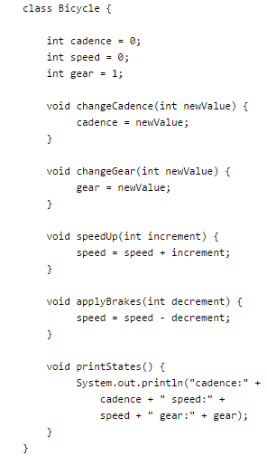
What is a Class?
A class is the blueprint from which individual objects are created.
  Your bicycle is an instance of the class of objects known as bicycles.
Session 02 - Learning the Java Language

Slide 36
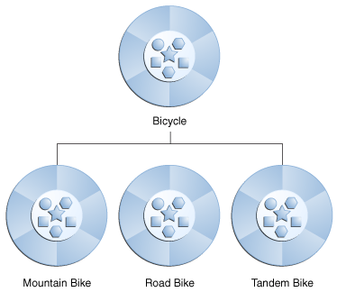
What is Inheritance?
Object-oriented programming allows classes to inherit commonly used state and behavior from other classes.
  Bicycle now becomes the superclass of MountainBike, RoadBike, and TandemBike
class MountainBike
extends Bicycle {
// new fields and methods defining
// a mountain bike would go here
}
Session 02 - Learning the Java Language

Slide 37
What is an Interface?
An interface is a group of related methods with empty bodies.
interface Bicycle {
/ wheel revolutions per minute
void changeCadence(int newValue);
void changeGear(int newValue);
void speedUp(int increment);
void applyBrakes(int decrement);
}
Session 02 - Learning the Java Language

Slide 38
What is a Package?
      A package is a namespace that organizes a set of related classes and interfaces.
      The Java platform provides an enormous class library (a set of packages) suitable for use in your own applications called API.
    For example, a String object contains state and behavior for character strings.
Session 02 - Learning the Java Language

Slide 39
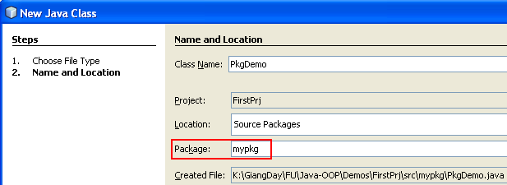
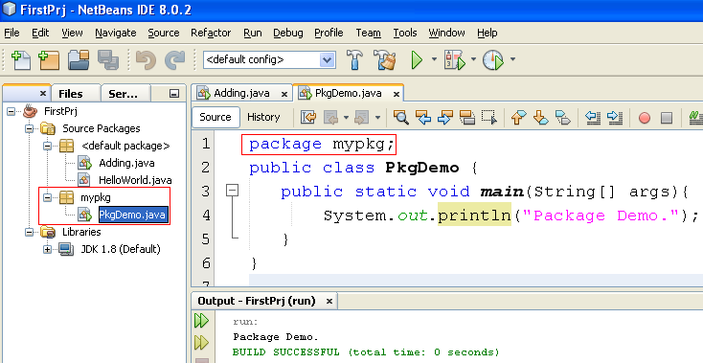
User-Defined Package
      Add a Java class
If package is used, it must be the first line in Java code
Session 02 - Learning the Java Language

Slide 40
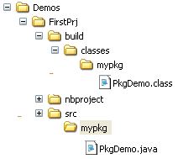
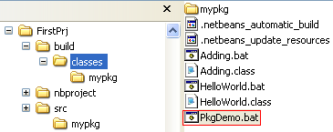
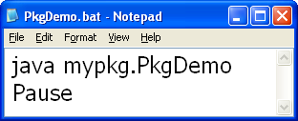
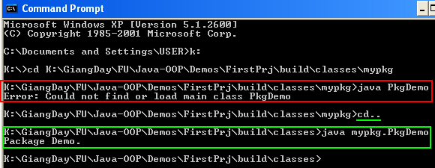
User-Defined Package
Session 02 - Learning the Java Language

Slide 41
Summary
The core concepts behind object-oriented programming: objects, interfaces, classes, and inheritance.
The traditional features of the language, including variables, arrays, data types, operators, and control flow.
Session 02 - Learning the Java Language

